Slide 1

Uncertainty-Aware Trajectory Optimization and Robust Control for Grid-Based Mobile Robots
(In Submission for Final M.Tech Thesis Project Evaluation)
Presented by :
Pritam Ranjan Kalita
MTech Robotics Engineering (4th Semester)
School of Advanced Engineering
Internal Project Supervisor:
Dr. Abhinav Sharma
Electrical Cluster
School of Advanced Engineering
External Project Supervisor:
Mr. Prashant Kumar Dwivedi
Chief Executive Officer
PRD Robotech Solutions

Slide 2
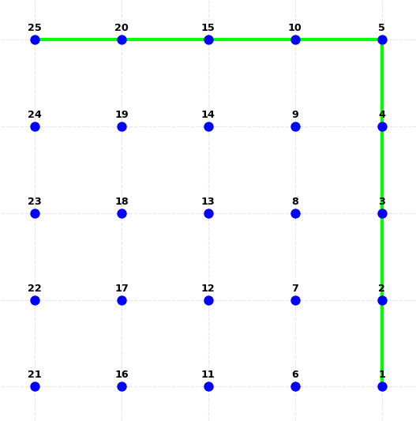
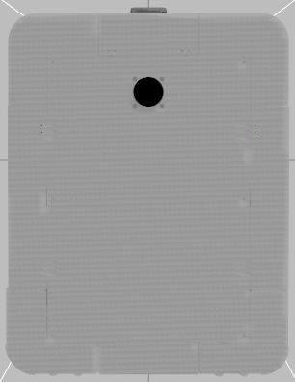
Introduction: Problem Statement Overview
A differential-drive robot operates in a grid-type map within an indoor industrial environment where each node is placed at a fixed distance apart from each other. There are no obstacles in the map.
The robot is required to navigate the planned path provided by the 4-way A* algorithm, following a stop–rotate–move execution strategy (in-place rotations allowed only).
Figure 1 : Working Environment (Map) of the Robot

Slide 3
Introduction: Problem Statement Overview
QR codes are placed at each of the nodes. They inform the robot of its ground truth position on the map.
Pose estimation relies on noisy odometry, IMU, and sparse QR corrections → uncertainty grows between two QR corrections.
The objective of this work is to achieve accurate trajectory tracking with minimal tracking error while moving between the nodes.
Figure 1 : Working Environment (Map) of the Robot

Slide 4
Literature Survey
Table 1: Summary of Important Research Papers found during Literature Survey
Sl.No | Title | Study & Findings
1 | Implementation of the Pure Pursuit Path Tracking Algorithm (1992) | The study is the foundational work that introduces the Pure Pursuit path-tracking algorithm for autonomous ground vehicles.
2 | Adaptive Pure Pursuit Model for Autonomous Vehicle Path Tracking (2017) | Instead of using a fixed lookahead distance, the algorithm adjusts the lookahead distance dynamically based on vehicle speed. Adaptive lookahead distance improves path tracking accuracy compared to standard Pure Pursuit
3 | Regulated Pure Pursuit for Robot Path Tracking (2023) | This paper introduces the Regulated Pure Pursuit (RPP) controller. It extends the traditional Pure Pursuit algorithm by introducing velocity regulation mechanism that consider path curvature and proximity to obstacles. The goal is to make Pure Pursuit suitable for industrial service robots operating in constrained environments. Successfully deployed on industrial service robot using ROS2 Nav2

Slide 5
Literature Survey
Sl.No | Title | Study & Findings
4 | Vehicle Path Tracking Control Using Pure Pursuit With MPC-Based Look-Ahead Distance Optimization (2024) | The paper proposes a modified Pure Pursuit controller where: The lookahead distance is treated as a control variable instead of a fixed or velocity-based parameter. A Model Predictive Control (MPC) framework is formulated to: Predict future vehicle motion + Optimize lookahead distance over a prediction horizon
5 | Stochastic Time-Varying Model Predictive Control for Trajectory Tracking of a Wheeled Mobile Robot (2021) | Proposes a stochastic MPC-based trajectory tracking controller considering state uncertainty. Models robot state with mean and covariance and uses prediction to handle uncertainty. Achieves better tracking accuracy and robustness under disturbances compared to conventional MPC.
6 | Stochastic Model Predictive Control (2017) | Foundational reference for SMPC theory; no experimental results. Explains how SMPC uses statistical models of uncertainties to guarantee constraint satisfaction.

Slide 6
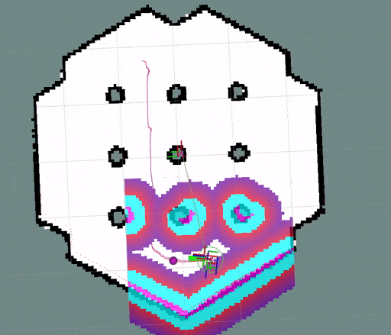
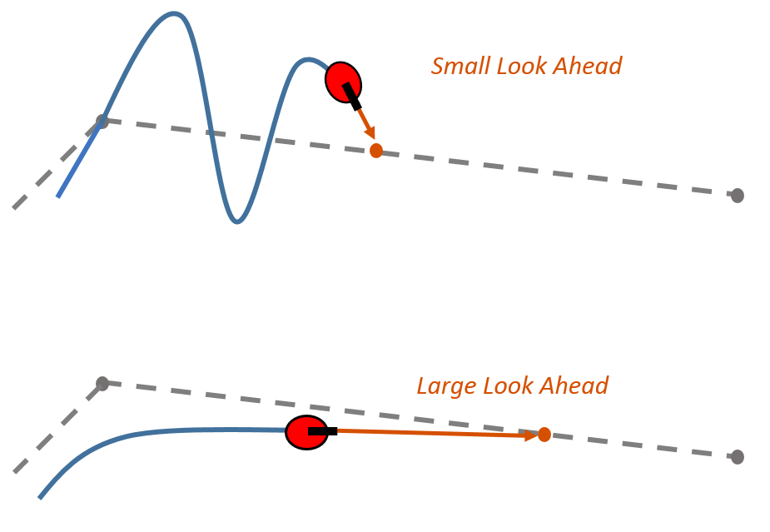
Research Gaps
The Regulated Pure Pursuit Controller (Macenski et al., 2023) which is a popular choice for trajectory tracking control in commercial wheeled mobile robots is heavily dependent on its lookahead distance parameter. The controller sets this parameter based on the current velocity of the robot [3]. However, it does not consider the position and orientation errors of the robot w.r.t the reference path while setting this parameter. This gives rise to the following problem – Trade-off between stability and tracking accuracy :
Small Lookahead – Higher Sensitivity to Path Tracking Error – Results in increased “jerky” motion.
Large Lookahead – Higher Motion Stability – slower path convergence.
Figure 2 : Illustration of the Pure Pursuit path tracking algorithm, where the robot continuously follows a lookahead point along the reference path. Source: https://user-images.githubusercontent.com/14944147/102563918-3cd49d80-408f-11eb-8e03-b472815a05d8.gif
Figure 3: Illustration of the Pure Pursuit controller showing the robot tracking a lookahead point along the reference path to compute steering commands. Source: MathWorks, Pure Pursuit Controller Documentation.

Slide 7
Research Gaps
The RPP controller assumes that the robot state [x, y, theta] is perfectly known any point in time and does not accommodate for state estimation uncertainties that may arise due to any kind of unknown/unforeseen disturbances (e.g., wheel slip, actuator slip, friction, terrain) that the robot might face during its trajectory execution in real-world – which ultimately increases the Path Tracking Error in real working conditions.
Figure 2 : Illustration of the Pure Pursuit path tracking algorithm, where the robot continuously follows a lookahead point along the reference path. Source: https://user-images.githubusercontent.com/14944147/102563918-3cd49d80-408f-11eb-8e03-b472815a05d8.gif
Figure 3: Illustration of the Pure Pursuit controller showing the robot tracking a lookahead point along the reference path to compute steering commands. Source: MathWorks, Pure Pursuit Controller Documentation.

Slide 8
Research Objectives
To propose an improved control strategy that gives better Path Tracking Accuracy in comparison to the baseline (RPP) while also keeping the robot’s motion smooth i.e less jerky motion.
To make the proposed controller robust towards robot state uncertainties arising due to external real-world disturbances.

Slide 9
Methodology
Part I : The Baseline Model

Slide 10
RPP
PID
1.1. The Baseline Model Overview
The complete project has been implemented using the Robot Operating System 2 Framework.
The trajectory tracking system is implemented using a hybrid control strategy combining two different controllers.
Straight path segments are tracked using the Regulated Pure Pursuit (RPP) controller, which computes velocity commands based on the lookahead distance. Replacing the RPP controller with a better improved version is the primary focus of this study.
RPP
Figure 4 : Different controllers used in the Baseline Model for controlling the Robot

Slide 11
RPP
PID
1.1. The Baseline Model Overview
90° In-place rotation at grid nodes are handled separately using a PID controller, enabling in-place rotation before proceeding to the next segment.
Overall motion follows a discrete execution pattern:
Stop → Rotate → Move Straight → Stop → Rotate → …
RPP
Figure 4 : Different controllers used in the Baseline Model for controlling the Robot

Slide 12
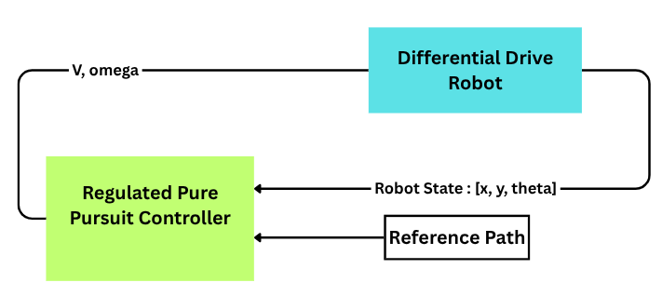
1.2. The Baseline Model Block Diagram (For Straight Path Travel)

Slide 13
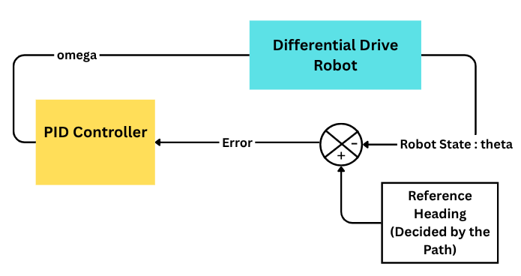
1.3. The Baseline Model Block Diagram (For In-Place Rotation)

Slide 14

1.4. PID Controller for In-Place Rotation
Adapted from “Introduction to PID Controllers”, RAW Control Theory Guide, 2024.
Available at: https://raw.org/book/control-theory/introduction-to-pid-controllers/
(1)
Here,
e_{k} = Path Heading - Current Robot Orientation (at time-step k)
⍵_{k} = Angular Velocity command at time-step k (abt. Z- axis)
K_{p} = 2.0
K_{i} = 0.0
K_{d} = 0.2
Δt ≈ 0.02 seconds
This output is then clamped to the range [max_vel, min_vel]. In simulation, max_vel = 0.8 rad/s. min_vel = 0.1 rad/s.
Tolerance = 0.2 Degrees

Slide 15
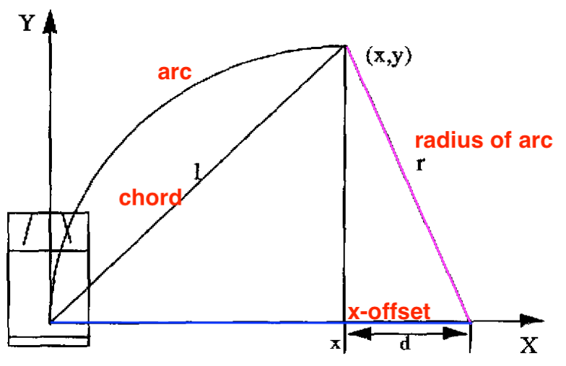
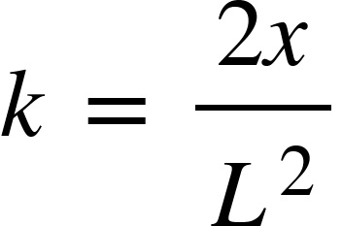
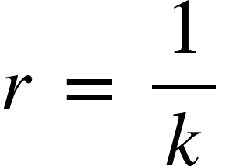
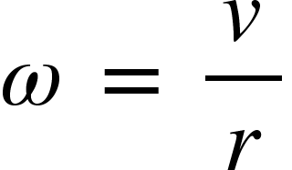
1.5. Regulated Pure Pursuit Controller : Mathematical Formulation
The Curvature of the Arc the the robot has to travel to reach the lookahead point is given by the following formula:
From curvature, the Radius of the Arc is calculated as :
From the radius, the angular velocity of the robot is calculated as:
Lookahead Point
(2)
Lookahead Distance L
Reference Path
(3)
x
Figure 5 : Geometry of the Pure Pursuit algorithm illustrating the relationship between the robot, lookahead point, and the circular arc used for trajectory tracking.
Source: Adapted from “Implementation of the Pure Pursuit Path Tracking Algorithm” by R. C. Coulter, Carnegie Mellon University, 1992.
(4)
Equation Source: Adapted from “Implementation of the Pure Pursuit Path Tracking Algorithm” by R. C. Coulter, Carnegie Mellon University, 1992.

Slide 16
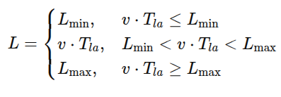
1.6. Regulated Pure Pursuit Controller : Lookahead Distance Heuristic
The Lookahead Distance in RPP controller algorithm is selected using the following velocity based heuristic rule:
Meaning of Each Term
L → Lookahead distance
L_{min}⁡ → Minimum lookahead distance
L_{max}⁡ → Maximum lookahead distance
v → Current linear velocity of the robot
T_{la}​ → Lookahead gain : Controls how aggressively lookahead increases with speed
In Baseline Implementation : L_{min}​= 0.4 m, L_{max} ​= 0.8 m, T_{la}​= 0.7s
Equation Source: Adapted from velocity-scaled lookahead formulation in “Regulated Pure Pursuit for Robot Path Tracking” by S. Macenski et al., Autonomous Robots, 2023, and Nav2 Regulated Pure Pursuit Controller documentation.
Available at: https://docs.ros.org/en/iron/p/nav2_regulated_pure_pursuit_controller/
(5)

Slide 17
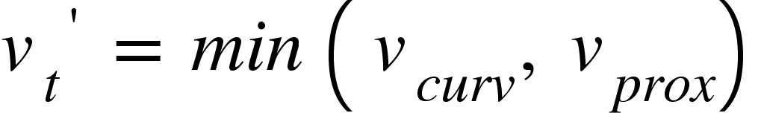
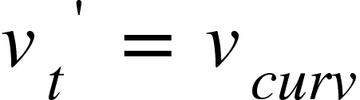
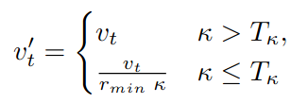
1.7. Regulated Pure Pursuit Controller : Velocity Heuristics
RPP applies two complementary heuristics to regulate the linear speed - a curvature heuristic and a proximity (obstacle) heuristic.
The final commanded linear speed is the most conservative value:
The Proximity Heuristic Rule is disabled in the current implementation hence :
Curvature heuristic (slowing down during sharp turns):
v_{t} is the maximum desirable linear velocity of the robot. κ is the path curvature at the lookahead point. In practice, this heuristic is activated only when curvature change κ exceeds a small threshold T_{κ} to avoid reacting to tiny path noise. Once the curvature heuristics is activated, the value r_{min} (decided by the control designer)​ decides how much the speed should be reduced.
In Baseline Implementation : r_{min} = 0.5 m, T_{k} = 2.0 m⁻¹.
Equation Source: Adapted from “Regulated Pure Pursuit for Robot Path Tracking” by Macenski et al., 2023.
(6)
Equation Source: Adapted from “Regulated Pure Pursuit for Robot Path Tracking” by Macenski et al., 2023.
(7)

Slide 18
Methodology
Part II : Stochastic Non-Linear Model Predictive Control For Adaptive Lookahead Distance in RPP Controller
(SNMPC-RPP Controller)

Slide 19
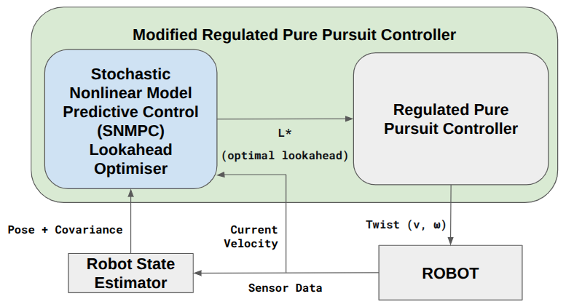
2.1. Proposed SNMPC‑RPP Controller Architecture
Only the lookahead selection of RPP is replaced – all other RPP modules (velocity regulation by curvature, collision checking) remain unchanged.
Inputs to the SNMPC optimizer (each control cycle, 5 Hz): Robot pose (x, y, θ) and its 3×3 covariance Σ_{pose} from the state estimator (e.g., EKF) and Robot forward speed v
Output: optimal lookahead distance L* → passed directly to the RPP geometric control law.
Preserves RPP simplicity – no changes to velocity regulation or collision checking.
Figure 6: SNMPC‑RPP Controller Architecture

Slide 20
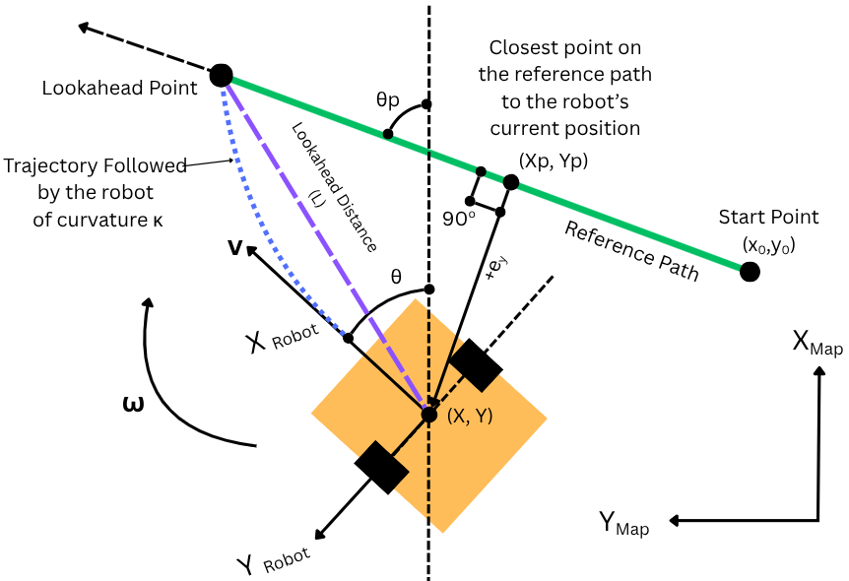
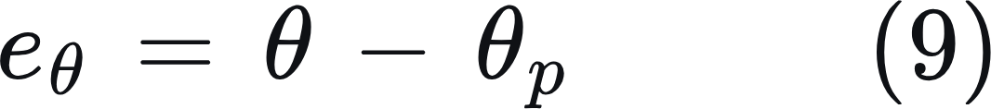
2.2. SNMPC‑RPP Controller: Path‑Relative Error – Definition and Geometry
The robot’s tracking performance is described by two errors relative to the current straight path segment:
Lateral error e_{y}– signed perpendicular distance from the robot to the path (positive = left of path):
Heading error e_{𝜃}– angular offset between robot heading and path direction:
  (x, y, θ) – robot pose in the global (map) frame
  (x_{o}, y_{o}) – start point of the current straight path segment (also in map frame)
  θp – heading angle of the path segment (counter‑clockwise from map X‑axis)
Figure 7: Path‑relative error geometry.

Slide 21
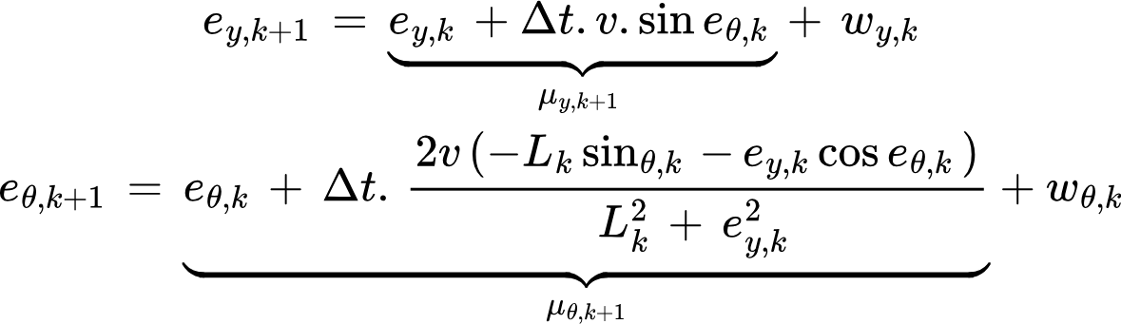
2.3. SNMPC‑RPP Controller: Stochastic Prediction Model
The Lateral and Heading errors are considered as states for SNMPC lookahead optimizer. At each discrete prediction time-step (Δt = 0.1s), the Lateral and Heading error states are calculated as:
μ_{y,k+1} & μ_{𝛳,k+1} : Deterministic part of the Lateral and Heading Errors at time step k+1.
⍵_{y,k} & ⍵_{𝜃,k} : Unmodeled Disturbance.
v – current robot forward speed (constant over prediction horizon)
L_{k} – lookahead decision variable at time step k
Note: Both equations derived are mathematically using equations 8, 9 and 4.
(10-11)

Slide 22
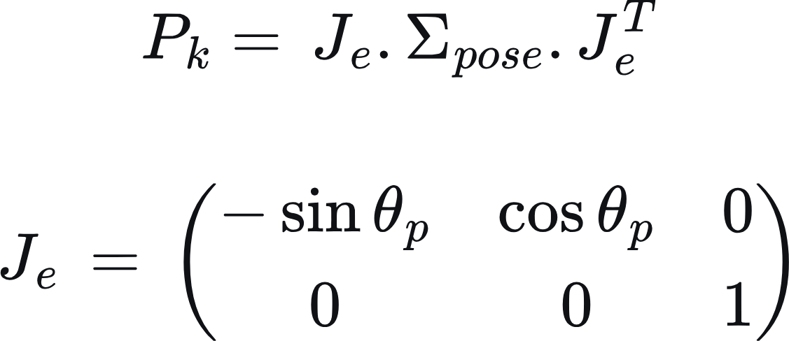
2.4. SNMPC‑RPP Controller: Initial Error Covariance
At time step k, the robot state estimator provides a 3×3 pose covariance Σ_{pose} in the map frame. We project it to the error state using the following equation:
Source: Simon, D. (2006). Optimal State Estimation. John Wiley & Sons. (See Chapter 5 on the Discrete-Time Kalman Filter for the covariance propagation equations.)
(12)

Slide 23
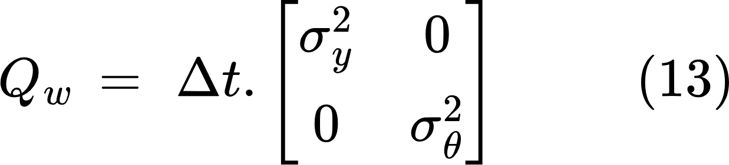
2.5. SNMPC‑RPP Controller: Process Noise Covariance
The Unmodeled Disturbances / Process Noises (wheel slip, floor irregularities – ⍵_{y,k} & ⍵_{𝜃,k}) are assumed to follow Gaussian Normal Distribution whose means are assumed to be equal to zero.
The covariance matrix for both the process noises calculated at each time step (Δt = 0.1s) is given as :
σ_{y} : Standard Deviation of the Process Noise for Lateral Error
σ_{𝜃} : Standard Deviation of the Process Noise for Heading Error
For simulations, σ_{y} = 0.003 m and σ_{𝜃} = 0.03 radian
Source : Kloeden, P. E., & Platen, E. (1992). Numerical Solution of Stochastic Differential Equations. Springer‑Verlag.
(Chapter 9, "Euler–Maruyama Method", gives the general discretization framework.)

Slide 24
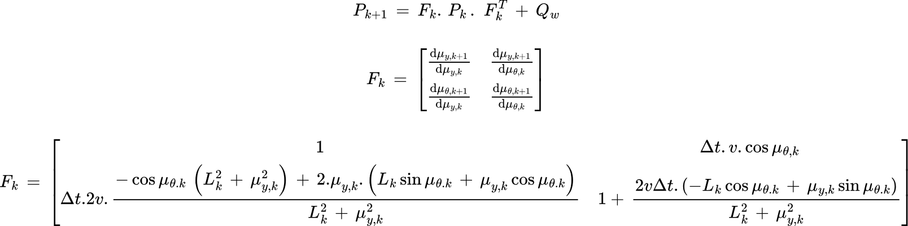
2.6. SNMPC‑RPP Controller: Error Covariance Propagation
The initial error covariance at time step k, is propagated through the future prediction steps using the following equation:
…(14)
Source: Maybeck, P. S. (1979). Stochastic Models, Estimation, and Control, Volume 1. Academic Press.
…(15)
…(16)

Slide 25
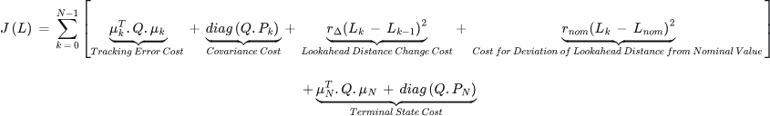
2.7. SNMPC‑RPP Controller: Cost Function
The final optimal sequence of N Lookahead Distances (one for each prediction step) L = [L₀, L₁, L₂,....,L_{N-1}], chosen by the optimization algorithm must produce the least possible (minimum) estimated of the below given cost function :
μ_{k} = [μ_{y,k}, μ_{𝜃,k}]^{T} = Deterministic Predicted Errors (Lateral & Heading) at time step k.
Q = diag [q_{y}, q_{𝜃}] = Penalty weights – penalises both errors as well as error covariances. For simulations, (q_{y}, q_{𝜃}) = (10,5).
P_{k} = Error Covariance Propagation at time step k.
L_{k} = Lookahead Distance at time step k.
r_{𝚫} = Penalty weight for Lookahead Distance change – discourages abrupt step‑to‑step changes in lookahead, preventing oscillatory control. For simulations, r_{𝚫} = 0.1.
L_{nom} = Nominal Lookahead Distance as suggested by the baseline RPP algorithm.
r_{nom} = Penalty weight for deviating from the Nominal Lookahead Distance – When tracking errors and uncertainty are small.
For simulations, r_{nom} = 1.0.
…(17)

Slide 26
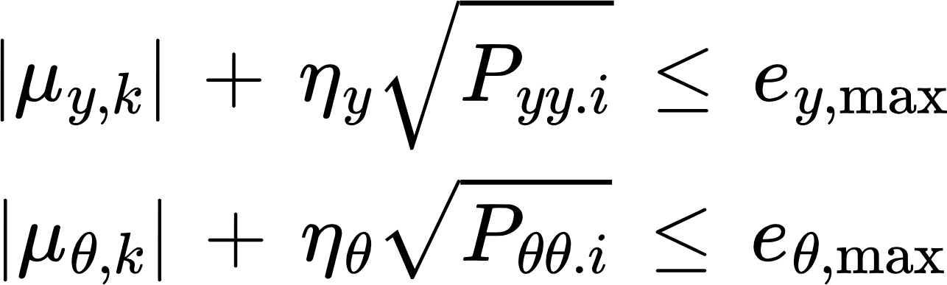
2.8. SNMPC‑RPP Controller: Chance Constraints (Safety Guarantees)
The SNMPC enforces probabilistic bounds on lateral error e_{y} and heading error e_{𝜃} at each predicted step
k = 1, …, N (k starts at 1 because the current state is measured, not predicted). This ensures that, despite uncertainty, the robot stays within safe limits with high probability.
For each prediction step k, the final lookahead distance sequence chosen by the algorithm must satisfy the below two conditions:
μ_{y,k}, μ_{𝜃,k} = Deterministic Predicted Errors (Lateral & Heading) at time step k
P_{y,y}, P_{𝜃,𝜃} = Corresponding diagonal entries of predicted covariance P_{k}.
η_{y}, η_{𝜃} = Confidence Multipliers. For simulations, η_{y}, η_{𝜃} = 2.6 → 99.5% confidence that the actual error does not exceed the bound.
e_{y,max}, e_{θ,max} = User‑defined safety bounds. For simulations, e_{y,max} = 0.12 m, and e_{θ,max} = 0.08 rad (4.6º Approx).
Source: Zheng, W., & Zhu, B. (2021). Stochastic time-varying model predictive control for trajectory tracking of a wheeled mobile robot. Frontiers in Energy Research, 9, 767597. DOI: 10.3389/fenrg.2021.767597
(18)
(19)

Slide 27
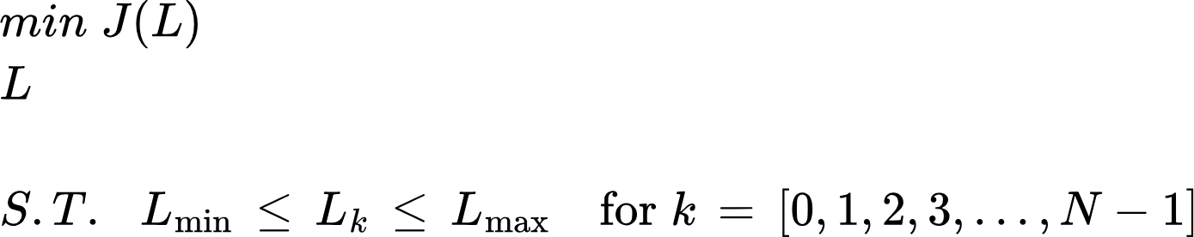
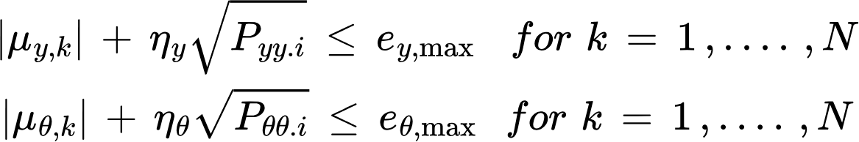
2.9. SNMPC‑RPP Controller: Hard-Box Constraint
In addition to chance constraints, the lookahead is bounded by:
In Simulation, L_{min}​= 0.4 m, L_{max} ​= 0.8 m
(20)
2.10. SNMPC‑RPP Controller: Final Optimization Equation
(21)

Slide 28
2.11. SNMPC‑RPP Controller: Solving the Optimization Problem
The optimisation problem (cost function + chance constraints + box constraints) is solved at each control cycle (5 Hz) using a derivative‑free method called Constrained Optimisation BY Linear Approximation (COBYLA)
Library: NLopt (open‑source, C++/C)
For simplicity, we have kept the control horizon = prediction horizon = 3 time steps of 0.1s each. Hence, sample Lookahead sequence = L₀, L₁, L₂
First control cycle: Initial guess = [(L_min+L_max)/2, (L_min+L_max)/2, (L_min+L_max)/2] = [0.6, 0.6, 0.6] m
Subsequent cycles: Shift previous optimal solution forward by one step (towards left), repeating the last value: [L₁*, L₂*, L₂*] as the initial guess for the new problem.
Benefit: Reduces number of function evaluations.

Slide 29
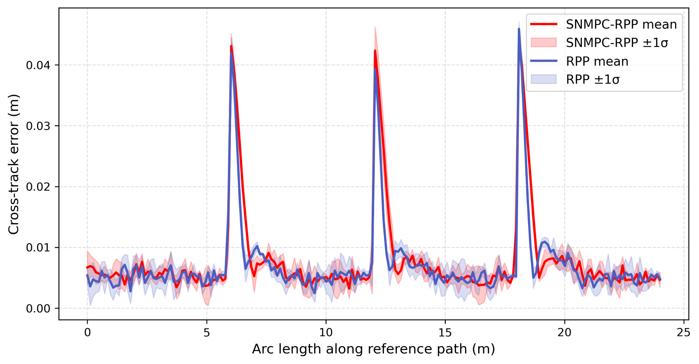
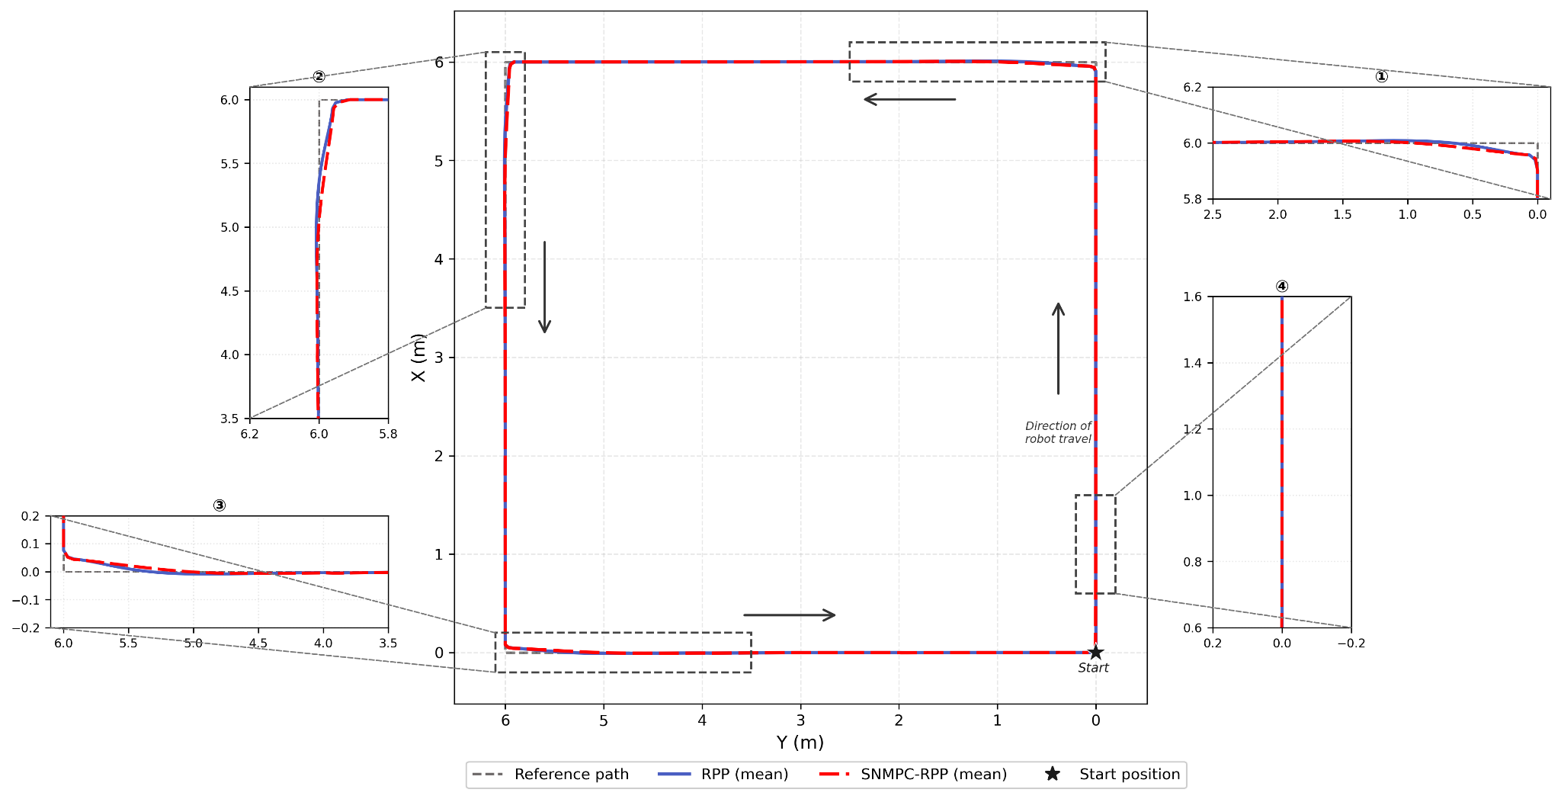
Results and Discussions
Case 1 : Desired Linear Speed = 0.5m/s (Anti-Clockwise)
Figure 8 : Mean trajectory overlays for RPP (solid blue) and SNMPC-RPP (dashed red) against the reference circuit (dashed grey) at desired speed v = 0.5m/s.
Figure 9: Cross-track error along the reference arc (mean ± 1σ across 5 runs per controller; SNMPC-RPP in red, RPP in blue) at desired speed v = 0.5m/s.

Slide 30
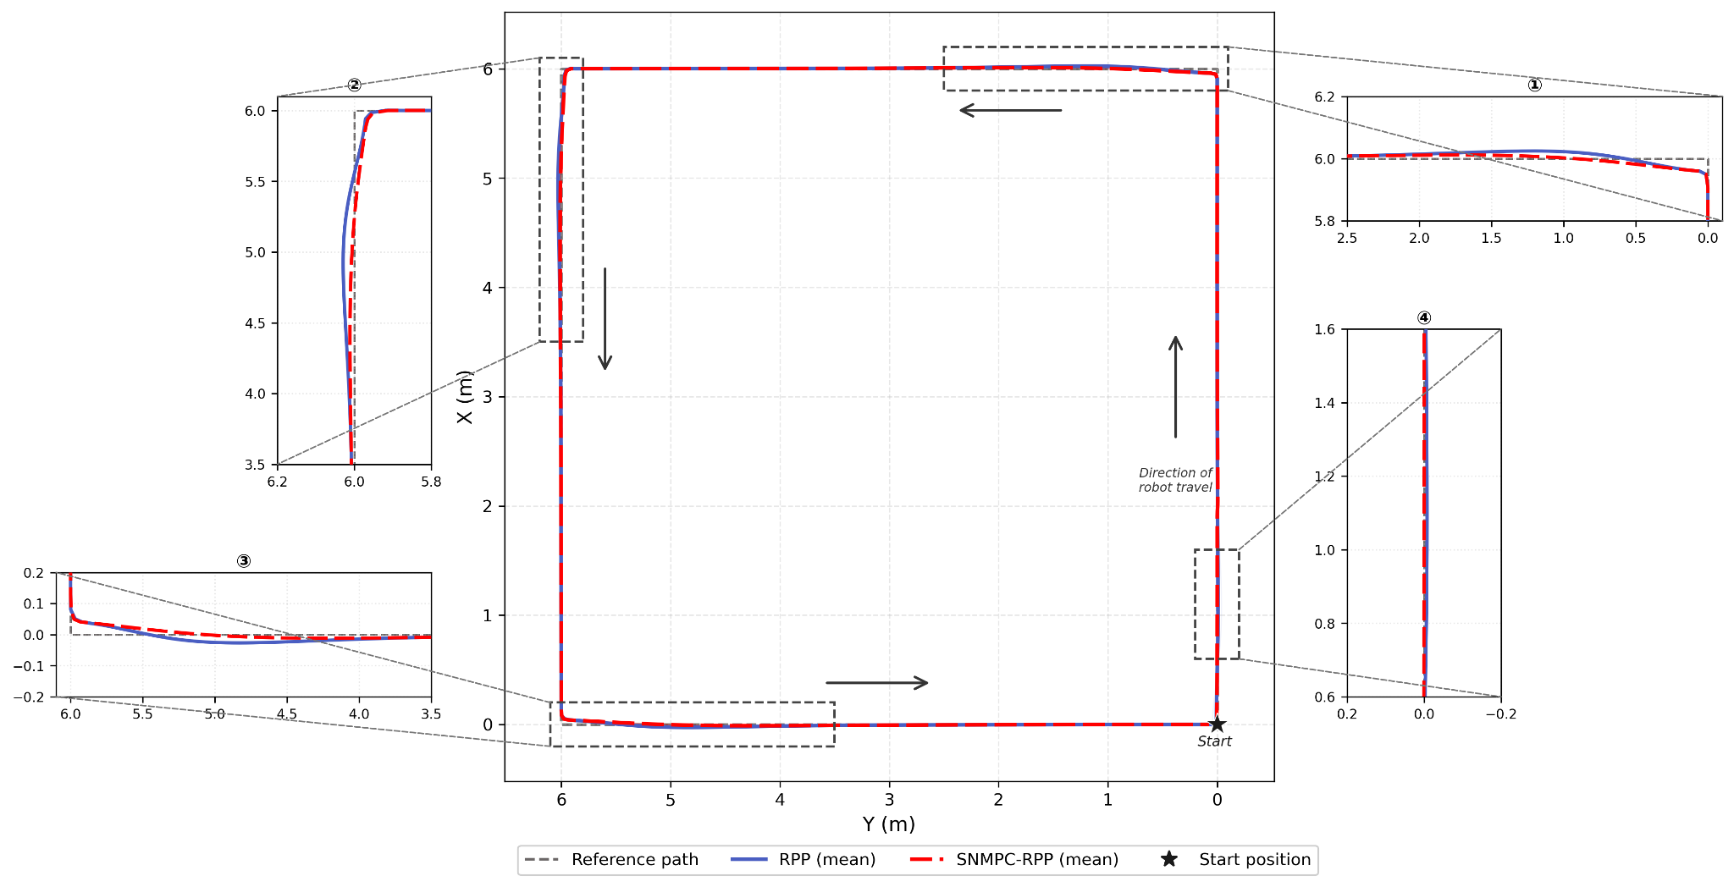
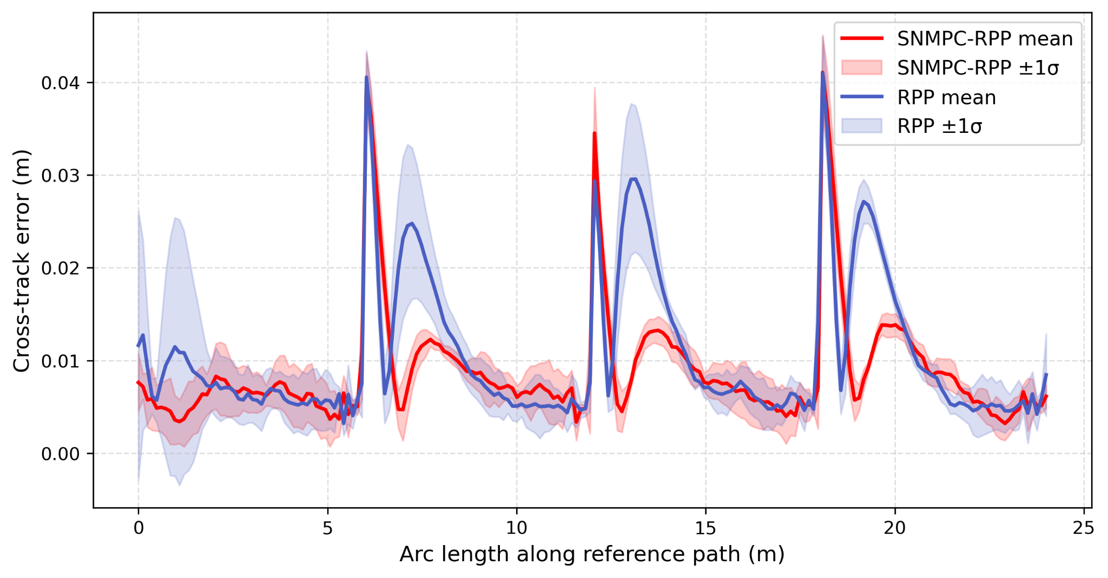
Case 2 : Desired Linear Speed = 1m/s (Anti-Clockwise)
Figure 10: Mean trajectory overlays for RPP (solid blue) and SNMPC-RPP (dashed red) against the reference circuit (dashed grey) at desired speed v = 1m/s.
Figure 11: Cross-track error along the reference arc (mean ± 1σ across 5 runs per controller; SNMPC-RPP in red, RPP in blue) at desired speed v = 1m/s.

Slide 31
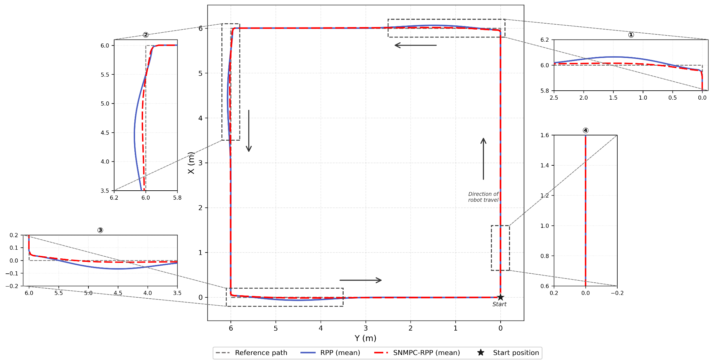
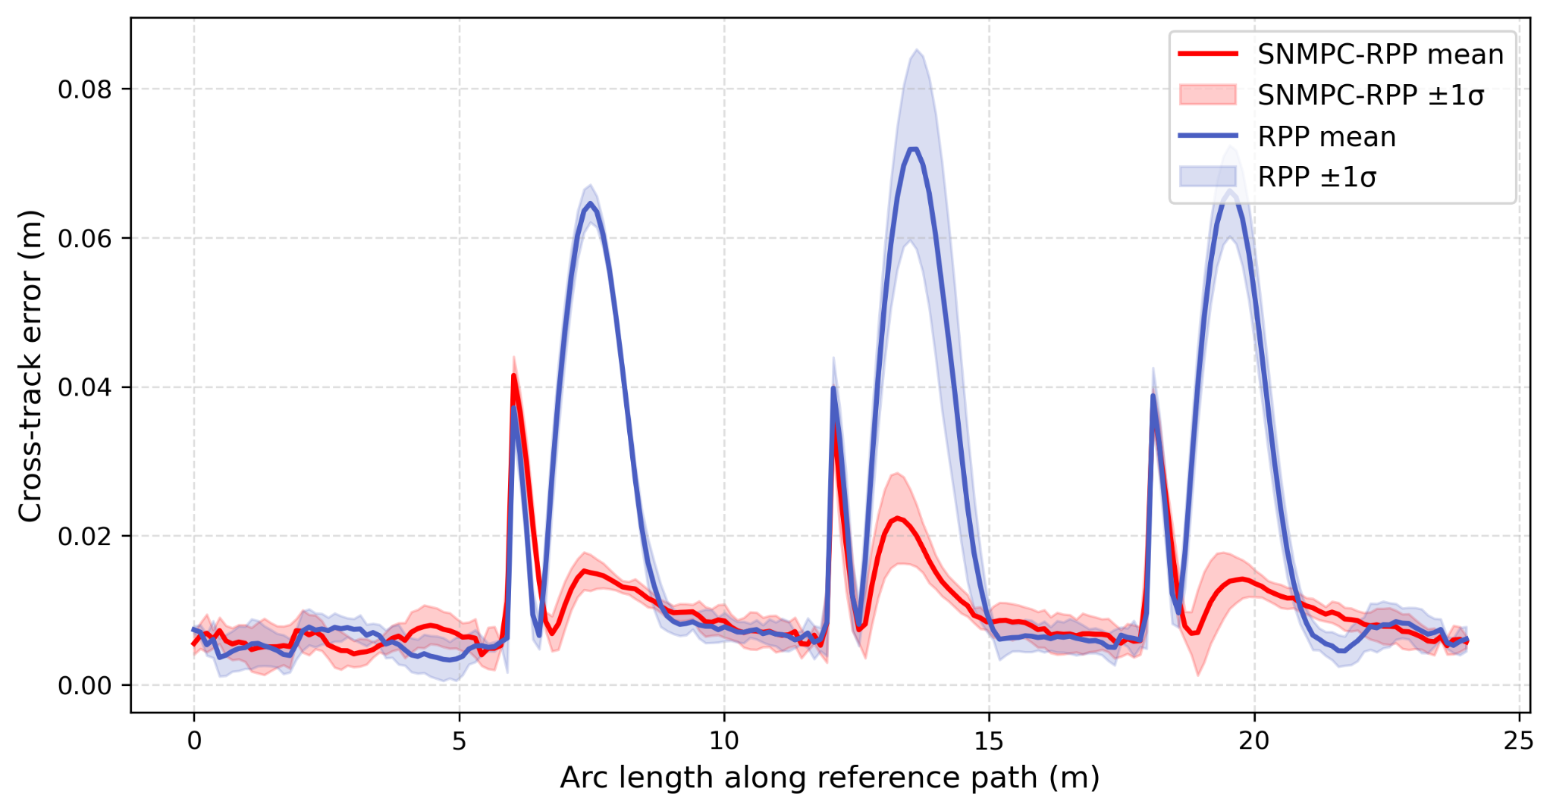
Case 3 : Desired Linear Speed = 1.5m/s (Anti-Clockwise)
Figure 12: Mean trajectory overlays for RPP (solid blue) and SNMPC-RPP (dashed red) against the reference circuit (dashed grey) at desired speed v = 1.5m/s.
Figure 13 : Cross-track error along the reference arc (mean ± 1σ across 5 runs per controller; SNMPC-RPP in red, RPP in blue) at desired speed v = 1.5m/s.

Slide 32
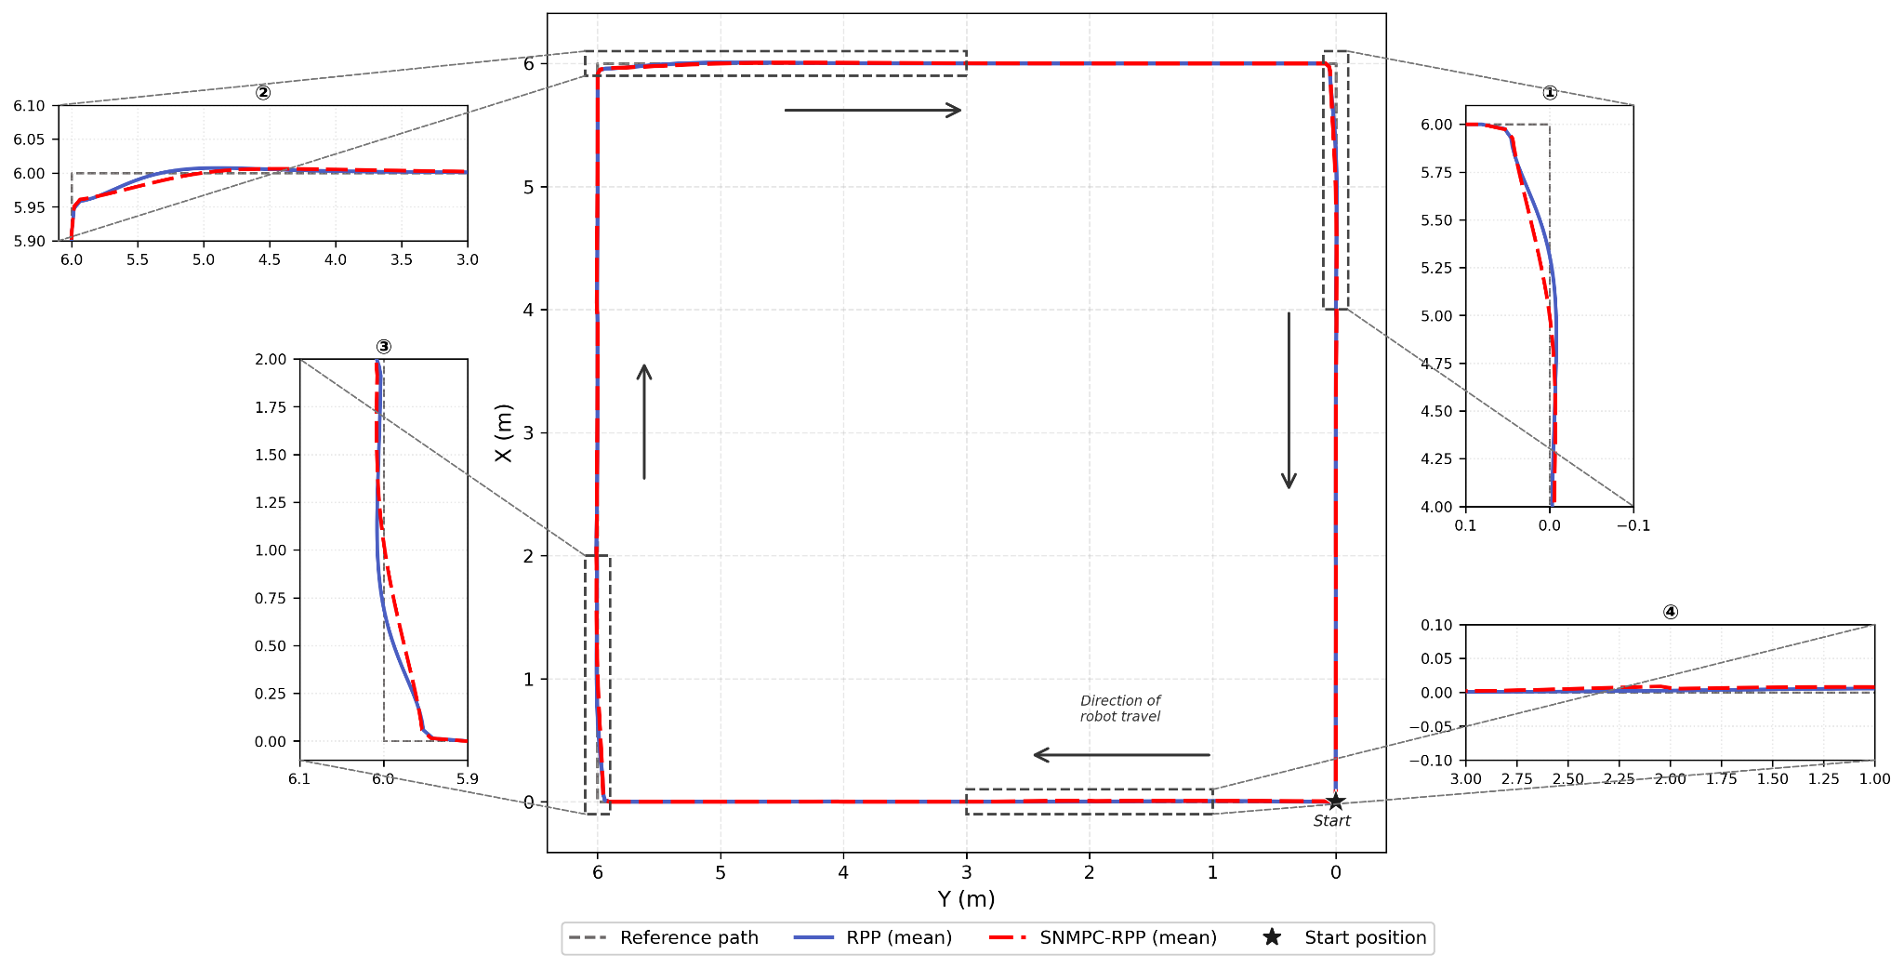
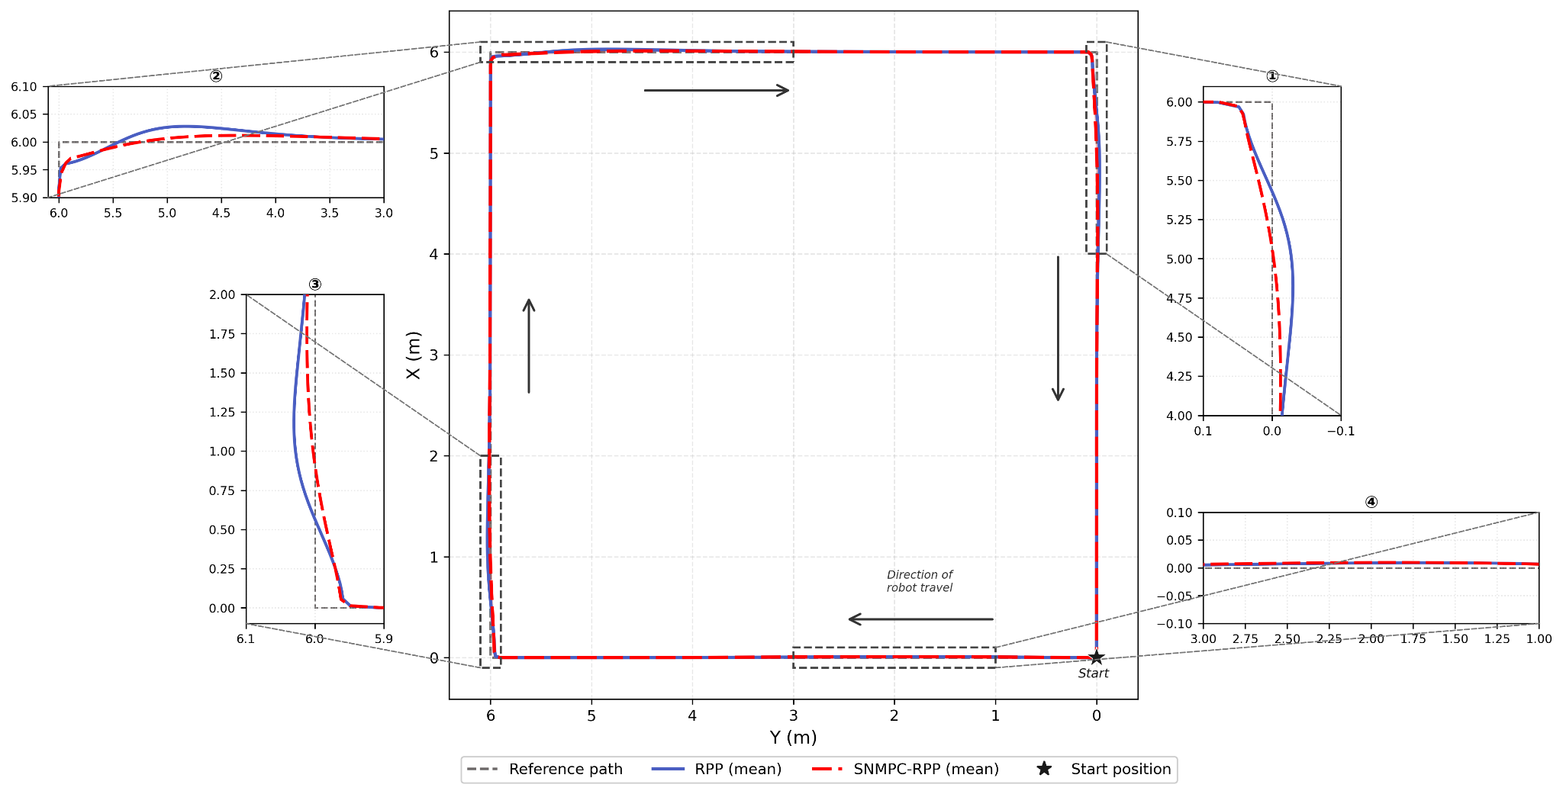
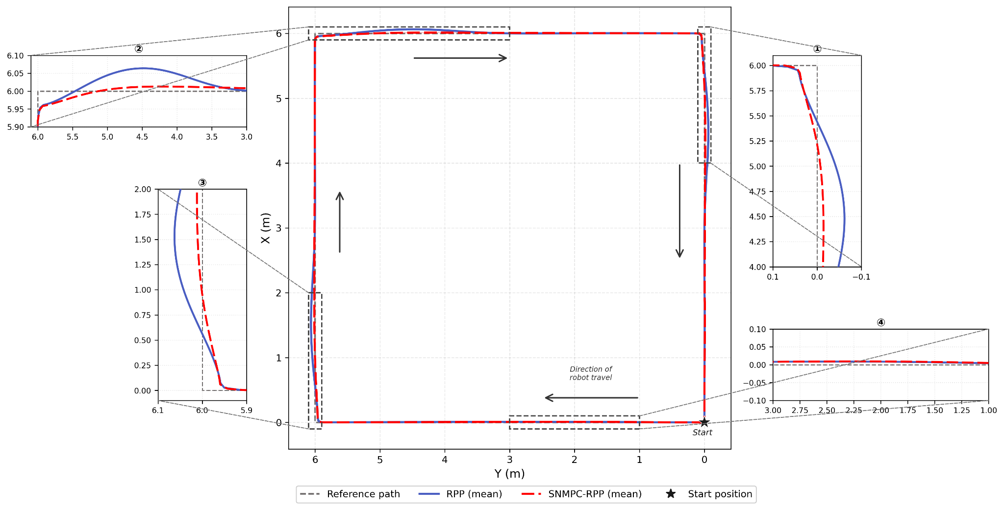
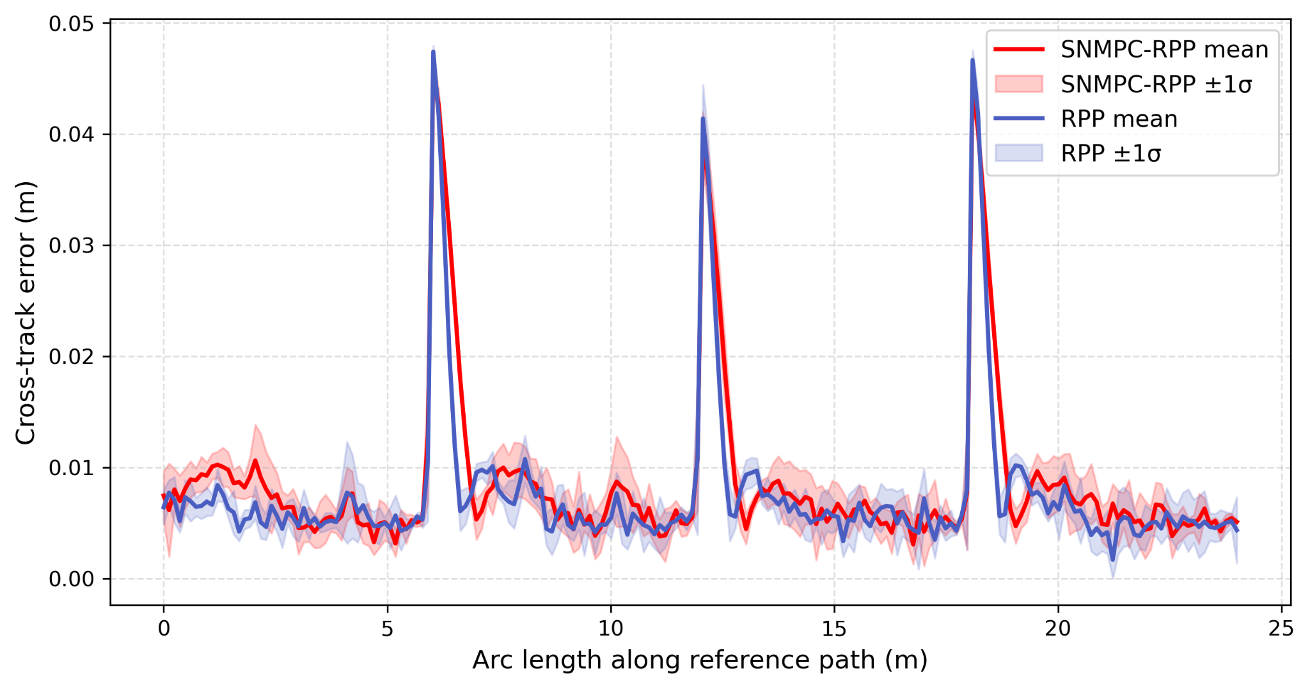
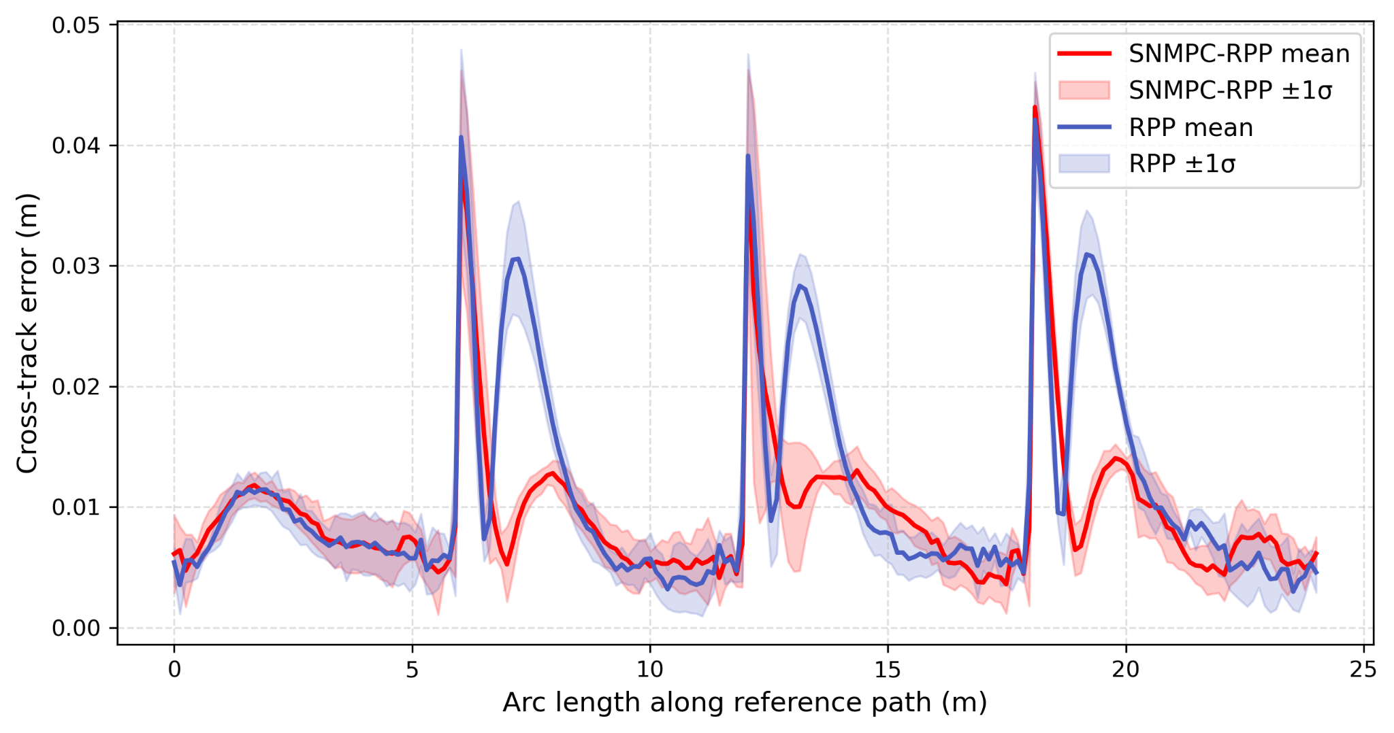
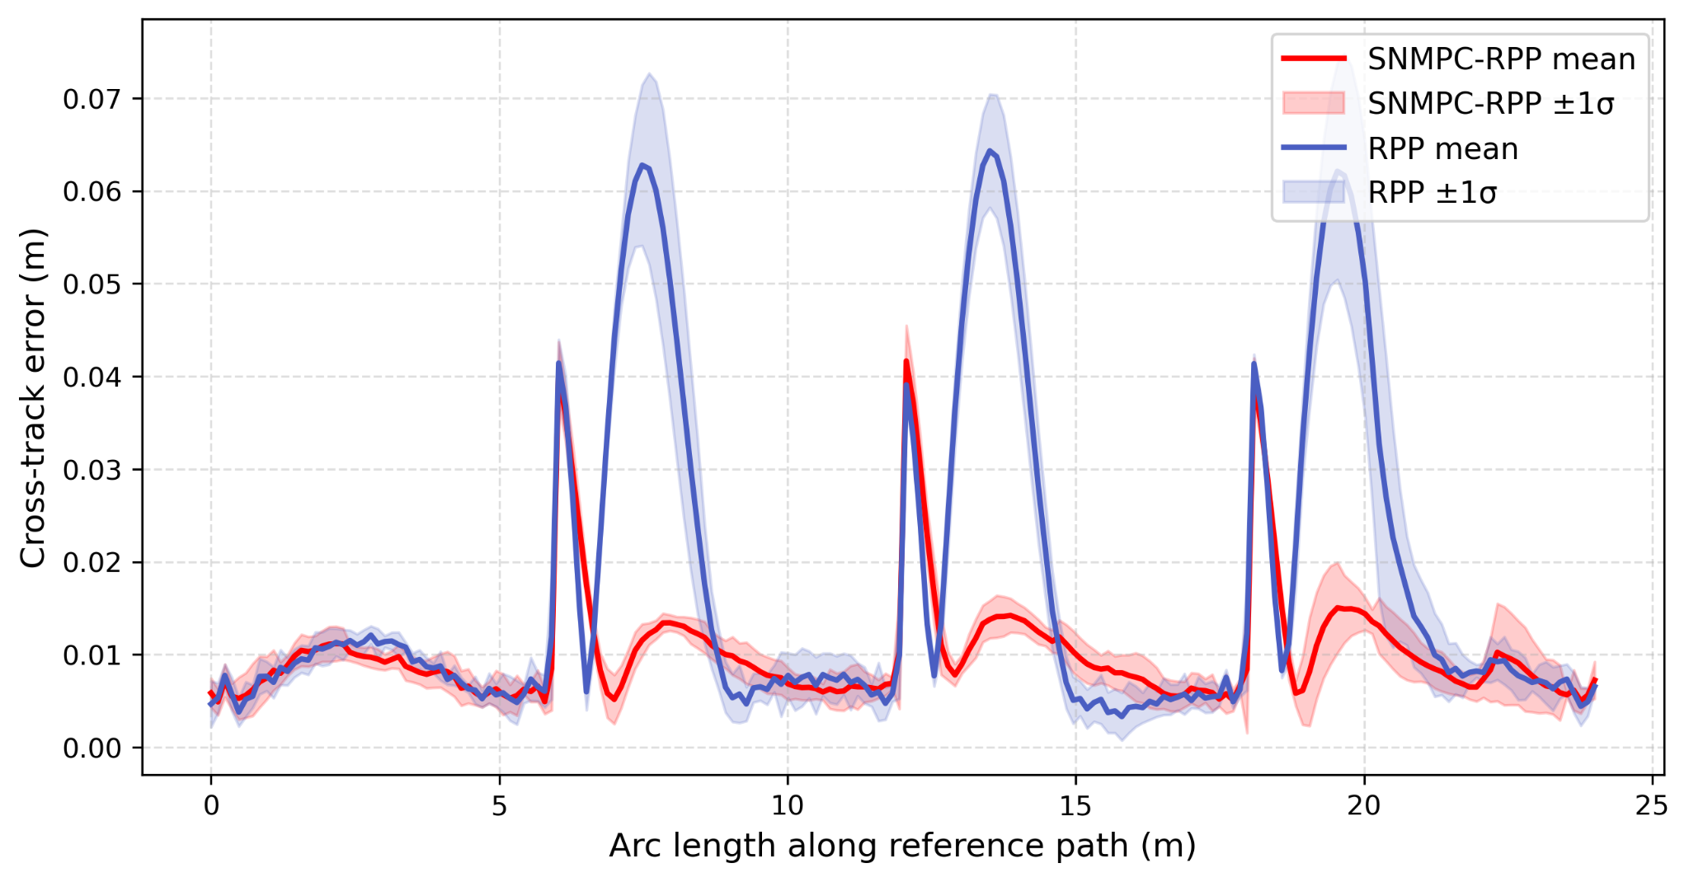
a)
b)
c)
Figure 14 : Mean trajectory overlays for RPP (solid blue) and SNMPC-RPP (dashed red) against the reference circuit (dashed grey) at desired speeds a) v = 0.5 m/s, b) = 1m/s and c) = 1.5 m/s – all while the robot traverses the rectangular circuit in clockwise direction.
a)
b)
c)
Figure 15: Cross-track error along the reference arc (mean ± 1σ across 5 runs per controller; SNMPC-RPP in red, RPP in blue) at desired speeds a) v = 0.5 m/s, b) = 1m/s and c) = 1.5 m/s – all while the robot traverses the rectangular circuit in clockwise direction.

Slide 33
Table 2: Cross-track error and mission duration: mean ± std across 5 runs per controller. Best MAE and RMSE per condition highlighted in bold.
Condition | Controller | MAE (mm) | RMSE (mm) | Max Dev (mm) | Duration (s)
0.5 m/s CW | RPP | 7.5 ± 0.2 | 10.4 ± 0.3 | 48.4 ± 1.1 | 192.9 ± 3.3
 | SNMPC-RPP | 8.5 ± 0.4 | 11.5 ± 0.4 | 46.8 ± 0.8 | 192.7 ± 1.2
0.5 m/s CCW | RPP | 7.1 ± 0.0 | 9.9 ± 0.1 | 47.7 ± 1.0 | 196.3 ± 1.4
 | SNMPC-RPP | 7.6 ± 0.4 | 10.8 ± 0.6 | 45.0 ± 2.1 | 193.0 ± 4.5
1.0 m/s CW | RPP | 11.1 ± 0.7 | 14.3 ± 0.9 | 44.0 ± 4.5 | 120.1 ± 1.9
 | SNMPC-RPP | 9.5 ± 0.6 | 11.7 ± 0.9 | 46.0 ± 1.6 | 121.1 ± 1.2
1.0 m/s CCW | RPP | 10.6 ± 0.8 | 13.7 ± 1.3 | 43.9 ± 1.2 | 129.9 ± 7.6
 | SNMPC-RPP | 8.7 ± 1.0 | 10.8 ± 0.6 | 42.8 ± 3.4 | 133.6 ± 4.4
1.5 m/s CW | RPP | 17.6 ± 0.7 | 25.5 ± 1.8 | 73.3 ± 9.2 | 97.1 ± 0.8
 | SNMPC-RPP | 10.2 ± 0.8 | 12.2 ± 0.9 | 44.3 ± 3.3 | 97.7 ± 1.4
1.5 m/s CCW | RPP | 17.9 ± 1.5 | 26.9 ± 2.9 | 75.7 ± 10.4 | 100.0 ± 0.8
 | SNMPC-RPP | 9.9 ± 0.5 | 11.9 ± 0.7 | 44.6 ± 1.7 | 96.9 ± 4.0

Slide 34
References
[1] Coulter, R. C. (1992). Implementation of the pure pursuit path tracking algorithm (Technical Report CMU-RI-TR-92-01). Carnegie Mellon University, Robotics Institute.
[2] Kong, L. (2017). Adaptive pure pursuit model for autonomous vehicle path tracking. International Journal of Science, 4(3), 70–73.
[3] Macenski, S., Singh, S., Martín, F., & Ginés, J. (2023). Regulated pure pursuit for robot path tracking. arXiv. https://arxiv.org/abs/2305.20026
[4] Kim, S., Lee, J., Han, K., & Choi, S. B. (2024). Vehicle path tracking control using pure pursuit with MPC-based look-ahead distance optimization. IEEE Transactions on Vehicular Technology, 73(1), 53–66.
[5] Zheng, W., & Zhu, B. (2021). Stochastic time-varying model predictive control for trajectory tracking of a wheeled mobile robot. Frontiers in Energy Research, 9, 767597. https://doi.org/10.3389/fenrg.2021.767597
[6] Mesbah, A., Kolmanovsky, I. V., & Di Cairano, S. (2018). Stochastic model predictive control. In Handbook of model predictive control (pp. 75-97). Cham: Springer International Publishing.

Slide 35
References
[7] X. Jiang, T. Kuroiwa, Y. Cao, L. Sun, H. Zhang, T. Kawaguchi, and S. Hashimoto, “Enhanced pure pursuit path tracking algorithm for mobile robots optimized by NSGA‑II with high‑precision GNSS navigation,” *Sensors*, vol. 25, no. 3, 2025. [Online]. Available: https://www.mdpi.com/1424-8220/25/3/745
[8] S. Kim, J. Lee, K. Han, and S. B. Choi, “Vehicle path tracking control using pure pursuit with MPC‑based look‑ahead distance optimization,” *IEEE Transactions on Vehicular Technology*, vol. 73, no. 1, pp. 53–66, 2024.
[9] K.‑H. Kim, H. Na, J. Ahn, S. Shin, and S. Hwang, “Modified pure pursuit algorithm robust to localization noise,” in *36th International Electric Vehicle Symposium and Exhibition (EVS36)*, 2023.
[10] C. Çiloğlu and E. Kutluay, “Performance improvement of pure pursuit algorithm via online slip estimation for off‑road tracked vehicle,” *Sensors*, vol. 25, no. 14, 2025. [Online]. Available: https://www.mdpi.com/1424-8220/25/14/4242
[11] C. Nantabut, “Unscented transform‑based pure pursuit path‑tracking algorithm under uncertainty,” in *Proceedings of the 21st International Conference on Informatics in Control, Automation and Robotics*. SCITEPRESS, 2024, pp. 182–189. [Online]. Available: http://dx.doi.org/10.5220/0012981400003822
[12] I. S. Mohamed, J. Xu, G. S. Sukhatme, and L. Liu, “Towards efficient MPPI trajectory generation with unscented guidance: U‑MPPI control strategy,” 2024. [Online]. Available: https://arxiv.org/abs/2306.12369

Slide 36
References
[13] O. Ezeji, M. Ziegltrum, G. Turrisi, T. Belvedere, and V. Modugno, “BC‑MPPI: A probabilistic constraint layer for safe model‑predictive path‑integral control,” 2025. [Online]. Available: https://arxiv.org/abs/2510.00272
[14] A. Trivedi, S. Prajapati, A. Shrigaonkar, M. Zolotas, and T. Padir, “Data‑driven sampling based stochastic MPC for skid‑steer mobile robot navigation,” 2024. [Online]. Available: https://arxiv.org/abs/2411.03289
[15] J. Tang, S. Wu, B. Lan, Y. Dong, Y. Jin, G. Tian, W.‑A. Zhang, and L. Shi, “GMPC: Geometric model predictive control for wheeled mobile robot trajectory tracking,” *IEEE Robotics and Automation Letters*, vol. 9, no. 5, pp. 4822–4829, 2024.
[16] E. Ghignone, N. Baumann, C. Hu, J. Wang, L. Xie, A. Carron, and M. Magno, “RLPP: A residual method for zero‑shot real‑world autonomous racing on scaled platforms,” 2025. [Online]. Available: https://arxiv.org/abs/2501.17311
[17] S. Sulaiman and A. Sudheer, “Implementation of pure pursuit algorithm based controller for a mobile platform,” in *Proc. 3rd International Conference on Robotics, Automation and Non‑Destructive Evaluation (RANE 2022)*, Apr. 2022, pp. 144–151.
[18] M. R. Hashim Al‑Dahhan, M. A. Alsaadi, R. R. Al‑Dahhan, and S. A. Aliesawi, “The art of navigation: Pure pursuit controller strategies for four‑wheeled mobile robots,” *Fusion: Practice & Applications*, vol. 15, no. 2, 2024.

